Slide 1
Специфика тестировоания в Life Science

Slide 2

Agenda
How we test – regulation details
What we test – case studies
Q&A

Slide 3
One big molecule in on object
1

Slide 4
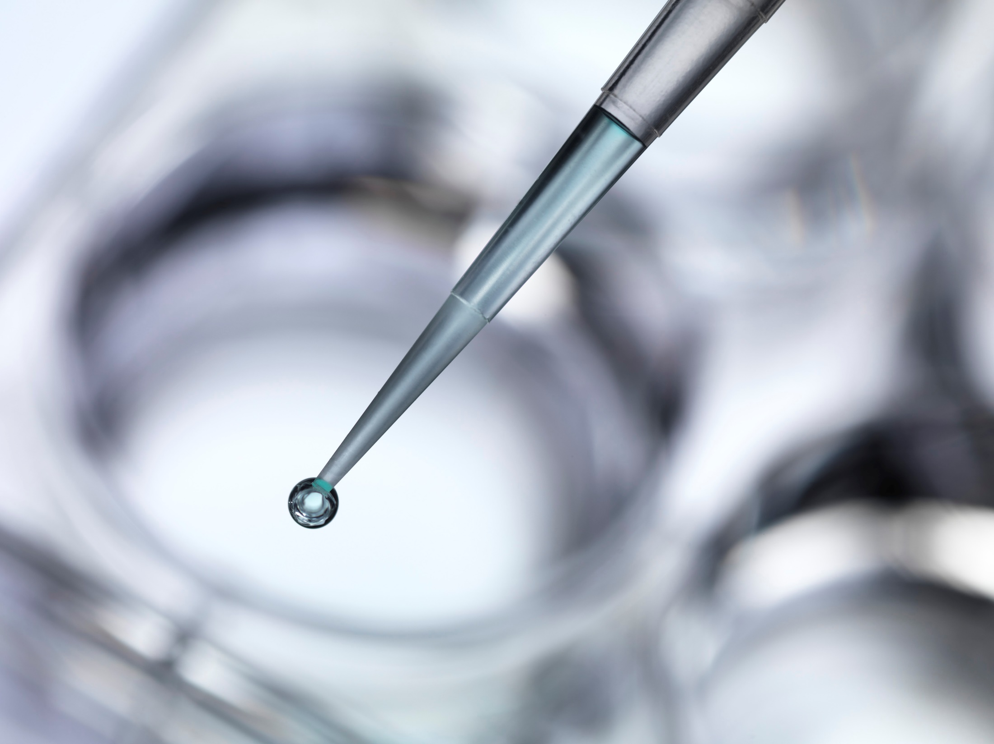
Pharmaceutical Industries
Innovative pharma
Generic pharma
Biotech
Contract Research and manufacturing
Notes:
Innovative pharma – компании разрабатывающие новые механизмы или соединения защищённые патентом
Generic pharma – компании которые могут производить женерики
Biotech – компании производящии лекарства на основании пептитов, протеинов и антител
Contract Research and manufacturing - аутсорс

Slide 5
Two small molecules in one object
2

Slide 6

Regulation
Government regulations controls the every stage of the development process
Research
Pre-clinical Development
Clinical Development
Manufacturing
USA: Food and Drug Administration (FDA)
UK: Medicines and Healthcare products Regulatory Agency (MHRA)
EU: European Medicines Agency (EMA)
Notes:
Research – исследования в конкретных областях (раковые заболевания, кардиология) молекулярные модели, химия и скриниг перспективных соединений
Pre-clinical Development – испытания на крысах и собаках
Clinical Development – испытания на людях – сперва на добровольцах, потом на пациентах, и потом – регистрационные испытания
European Medicines Agency (EMA) – координируется работу 27 национальных регуляторов
Прогнать телегу про конференцию гармонизации в 1990-м году

Slide 7
Two big molecules in one object
3

Slide 8

Regulatory documents
US GMP 211.63 (1978)
21 CFR 11 Electronic Records & Electronic signatures (1997)
FDA Guidance on Part 11 Scope and Application (2003)
FDA Guidance on General Principles of S/W Validation (2003)
EU GMP 3.4 Equipment (2003)
EU GMP Annex 11 Computerized Systems (2011)
EU GMP Chapter 4 Documentation
Notes:
GMP – Good Manufacturing practices Прогнать телегу про электронные подписи

Slide 9
4
5
6

Slide 10

What is Computerized System
Computer system
Software (OS and Applications)
Hardware and peripherals
Standard operating procedures
Network
Controlled Process
Instrument (Firmware)
Standard operating procedures
People
Computer system + Controlled Process = Computerized systems
Notes:
People = trained staff

Slide 11
7
8
9
10
11
12

Slide 12
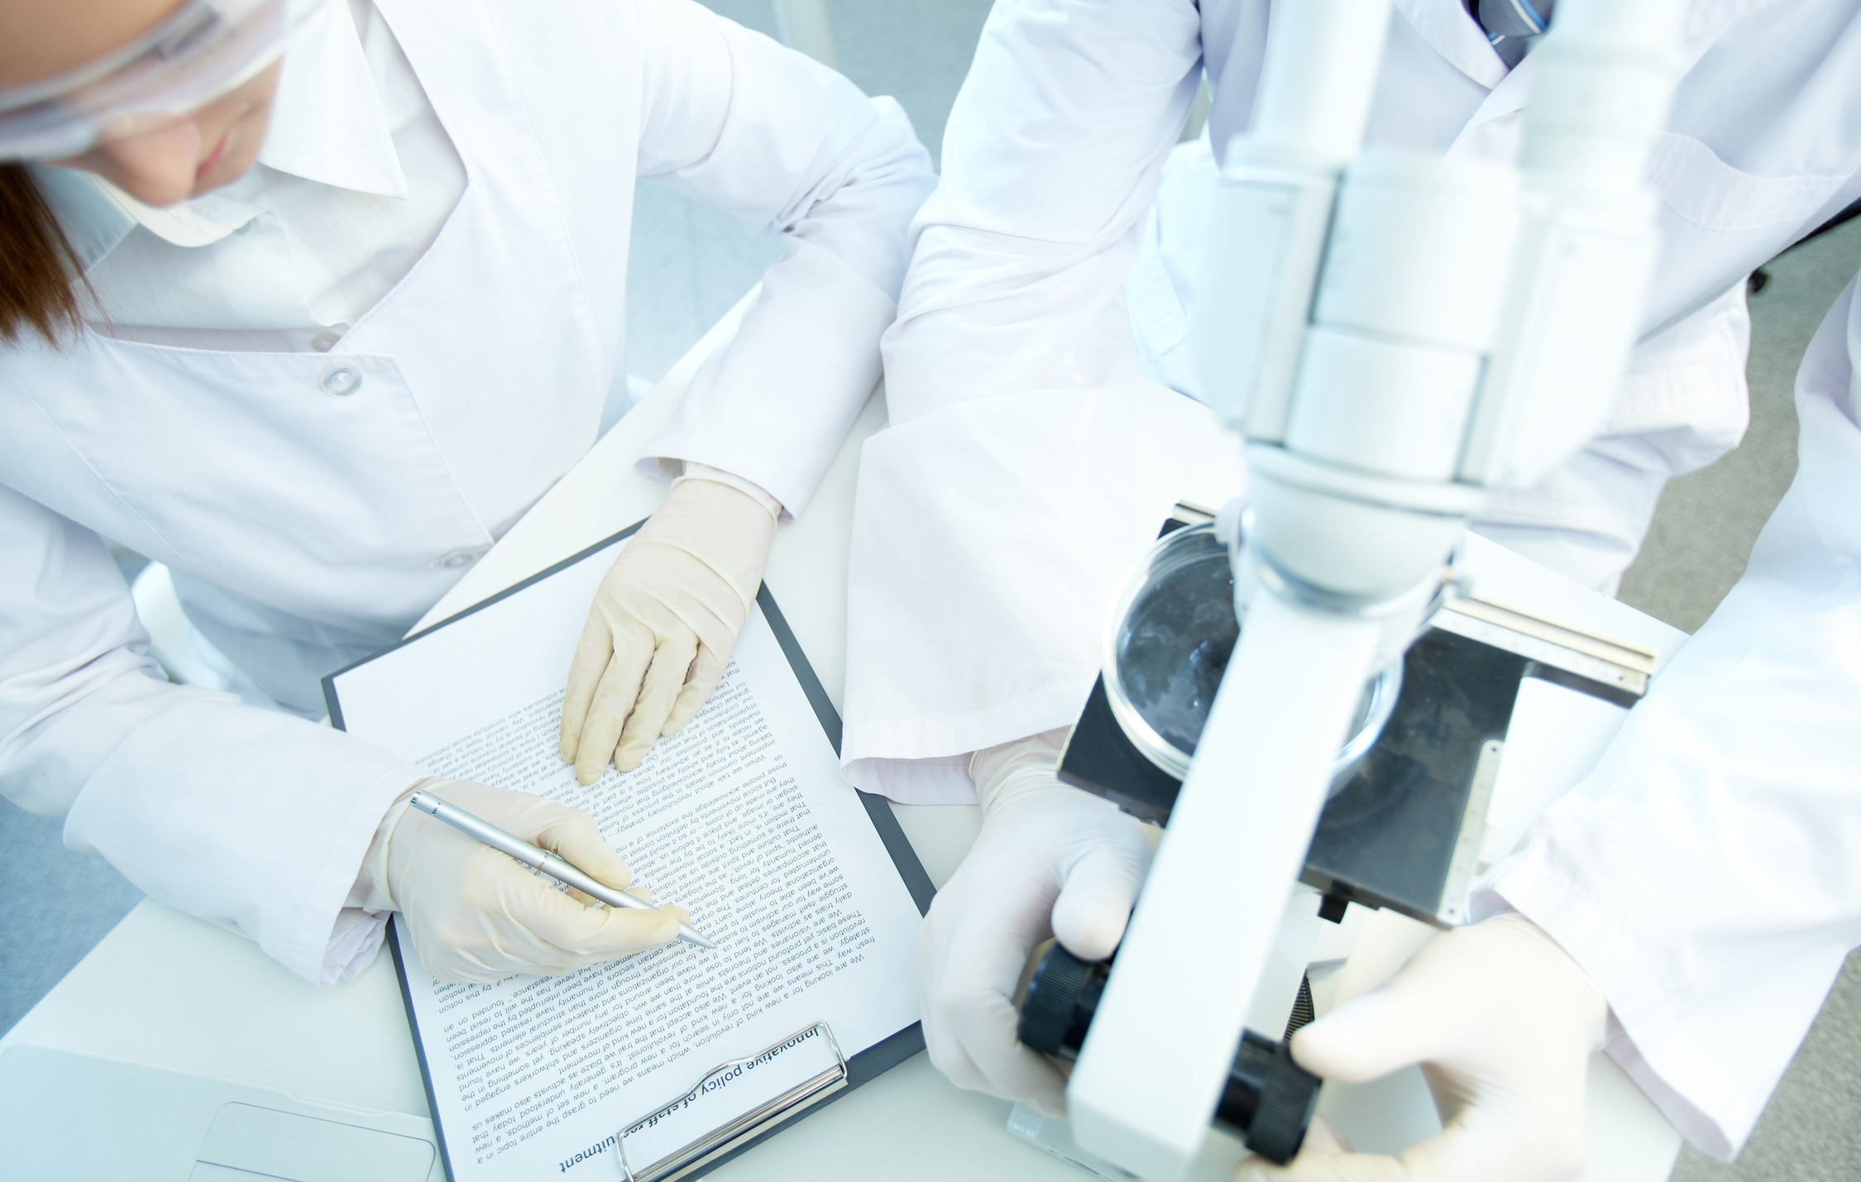
Intended use of equipment
Company must demonstrate fitness for purpose of all equipment and computerized systems to comply with the regulations
Majority of computerized systems are purchased, so regulations require us to validate each system
Part of validation is to check the quality of system development and support by the audits of software suppliers
Notes:
Одна из вещей за которой следит регулятор следит за тем, что бы всё делалось надлежащим образом в соответсвии с правилами. В том числе – оборудование и компьтеризированные системы которые использовались используются именно для того, для чего они предназначены
Большая часть компьютеризированных систем состоит из компонентов произведённых сторонними производителями, поэтому все эти компоненты тоже должны удовлетворять регуляторным правилам
Частью этих проверок является контрол за девелопментом и суппортом софта который производят компании
Часто спрашивают – Что является признаком качества софта? Что лежит в основе качественного софта?

Slide 13
13

Slide 14
Computerized System Validation (CSV)
CSV – does the computer system do what the customer thinks it does?
Customer must validate the system
Plan the validation
Define life cycle used
Manage the risk due to system and process
Documented evidence of activities (user requirements, traceably, correct installation, configuration documented and testing versus requirements)
Report validation and release system for use
If system uses 3-rd party libraries/products their suppliers must be assessed in the same way
Notes:
Приёмочные испытания софта Часто спрашивают – Что является признаком качества софта? Что лежит в основе качественного софта?
Ответ – делает ли система то, что заказчик думает, что она должна делать
Заказчик (покупатель) софта должен иметь возможность провести приёмосдаточные испытания.
В реальности – эта проверка не что иное как хорошо задокументированная часть процесса разработки софта
Которая включает в себя план проверки, определенный и задокументированный цикл разработки частью которого является учёт и принятие во вримание рисков которые несёт использование продукта. Для продуктов которые являются критически важными сами по себе или в составе системы – работы будет больше чем над продуктами которые несут вспомогательную роль.
Обязательной частью процесса должно быть наличие документальных свидетельств всех действий в процессе разработки (требования, матрица соотвествия разрабатываемых фич и требований к продукту, свидетельства о том, что разрабатываемый продукт правильным образом сконфигурированы и установлены)

Slide 15
14

Slide 16
CSV – is Good S/W Engineering Practice
Process owner is responsible for validation
Team activity: Users, QA, IT and vendor’s specialists
Planned activity
Formal documented requirement
Define user requirements and to show intended purpose
Documented tested
Four eyes principals: one person & one person checks
Control change
Report work and release system for use
Notes:
Process owner – обычно это начальник лаборатории или департамента
Приёмочные испытания – это обычно командная работа в которой участвуют пользователи QA заказчика, IT и представители поставщика
Это обязательное действие частью которого мы определяем требования в рамках которых должны показать что система соотвествует требованиям проведя User Acceptance Testing
Это гарантирует что система делает то, для чего предназначена
Процесс тестирования обязан быть задокументирован, обязательно наличие тест-кейсов или авто-тестов написанных ДО испытаний в обязательно должны содержать шаги исполнения и содержать acceptance criteria, свидетельств результатов их исполнения 4 глаза – один исполняет, один проверяет исполнение – оба должны одинаково понимать результат исполнения
Все изменения внесенные в процессе должны быть задокументированы

Slide 17
15
16

Slide 18
Mandatory Obligations
SW must ensure Data Quality and Integrity
Data creation/modification can only be made by authorized personnel
It must be possible to track any data changes: who what when, old and new data values
Follow common regulatory compliance requirement
Say what you do
Have a written procedure that states what you do
Do what you say
Follow the procedure, in case of deviation – write what was done and consider procedure revise
Document it
Written and electronic evidence is needed to demonstrate that procedure was followed
Notes:
Audit trails

Slide 19
17
18
19
20

Slide 20
Key differences all together
Four eyes principals
Data Quality and Integrity
Traceability and Ownership

Slide 21
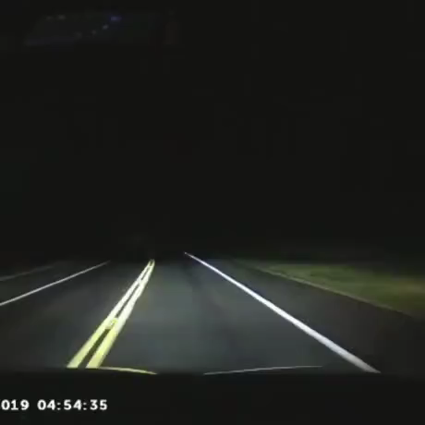
C1=CC(=CC=C1C(CC(=O)NC(=NCCCC2=CN=CN2)N)C3=CC=C(C=C3)F)F
21
CCCC1=NN(C2=C1N=C(NC2=O)C3=C(C=CC(=C3)S(=O)(=O)N4CCN(CC4)C)OCC)C
22

Slide 22
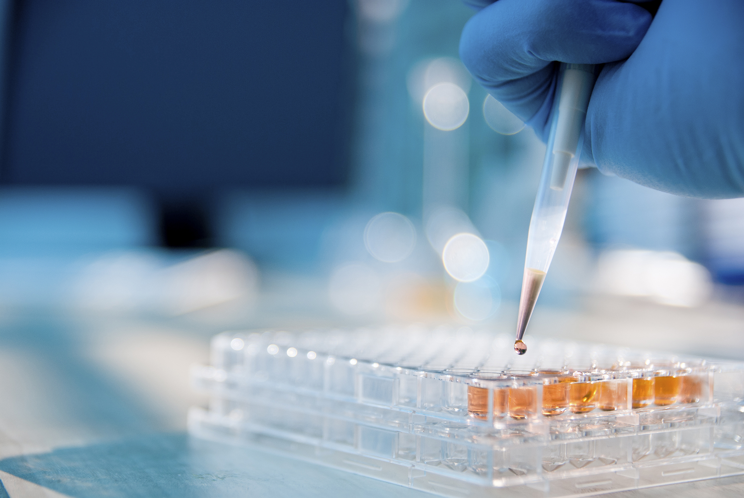

Slide 23
CCCC1=NC(=C2N1N=C(NC2=O)C3=C(C=CC(=C3)S(=O)(=O)N4CCN(CC4)CC)OCC)C
CC1OC2C(O)C(O)C(OC3C4C(=CC5OCOC=5C=4)C(C4C=C(OC)C(O)=C(OC)C=4)C4C3COC4=O)OC2CO1.CCC1(O)CN2CC(CC(C(OC)=O)(C3C=C4C56C(N(C)C4=CC=3OC)C(O)(C(OC)=O)C(OC(C)=O)C3(CC)C=CCN(C53)CC6)C3NC4C(=CC=CC=4)C=3CC2)C1.CCCCCCCCCCCCCCCCCC(O)=O.CCC1OC(=O)C(C)C(OC2OC(C)C(O)C(OC)(C)C2)C(C)C(OC2OC(C)CC(N(C)C)C2O)C(O)(C)CC(C)C(=O)C(C)C(O)C1(O)C.CCCCCCCCCCCCOS(O)(=O)=O.CC[C@H]1OC(=O)[C@H](C)[C@@H](O[C@@H]2O[C@@H](C)[C@H](O)[C@@](OC)(C)C2)[C@H](C)[C@@H](O[C@@H]2O[C@H](C)C[C@H](N(C)C)[C@H]2OC(CC)=O)[C@@](O)(C)C[C@@H](C)C(=O)[C@H](C)[C@@H](O)[C@@]1(O)C.C1C(O)=C(O)C(O)=CC=1C(OC1C(O)=C(O)C=C(C(OCC2OC(OC(C3C=C(OC(C4C=C(O)C(O)=C(O)C=4)=O)C(O)=C(O)C=3)=O)C(OC(C3C=C(OC(C4C=C(O)C(O)=C(O)C=4)=O)C(O)=C(O)C=3)=O)C(OC(C3C=C(OC(C4C=C(O)C(O)=C(O)C=4)=O)C(O)=C(O)C=3)=O)C2OC(C2C=C(OC(C3C=C(O)C(O)=C(O)C=3)=O)C(O)=C(O)C=2)=O)=O)C=1)=O
23
CC1(C2CCC3(C(C2(CCC1OC4C(C(C(C(O4)C(=O)O)O)O)OC5C(C(C(C(O5)C(=O)O)O)O)O)C)C(=O)C=C6C3(CCC7(C6CC(CC7)(C)C(=O)O)C)C)C)C
24
25

Slide 24
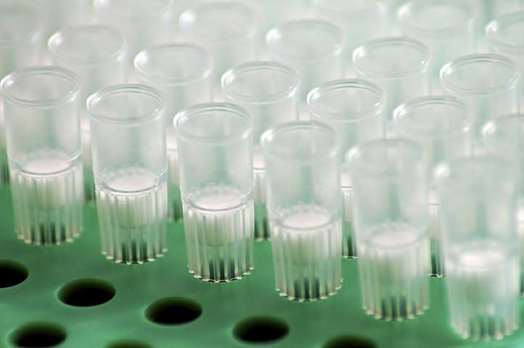

Slide 25
C[C@H]1[C@@H]([C@@H](C[C@@H](O1)O[C@H]2[C@H]3C(=O)N[C@@H](C4=C(C(=CC(=C4)O)O)C5=C(C=CC(=C5)[C@H](C(=O)N3)NC(=O)[C@H]6C7=CC(=C(C(=C7)OC8=C(C=C2C=C8)Cl)O[C@H]9C([C@H]([C@@H]([C@H](O9)CO)O)O)O[C@H]1C[C@H]([C@H]([C@@H](O1)C)O)N)OC1=CC=C(C=C1)[C@H]([C@H](C(=O)N[C@H](C(=O)N6)C1=CC=C(C=C1)O)NC(=O)[C@@H](C1=CC=C(C=C1)O[C@H]1[C@@H]([C@@H]([C@H]([C@@H](O1)C)O)O)O)NC)O)O)C(=O)O)N)O
CCOCC[PH+](CC[PH+](CCOCC)CCOCC)CCOCC.CCOCC[PH+](CC[PH+](CCOCC)CCOCC)CCOCC.O=[99Tc]=O.C[C@@H](O)[C@@H]1NC(=O)[C@H](CCCCN)NC(=O)[C@@H](CC2C3C(=CC=CC=3)NC=2)NC(=O)[C@H](CC2C=CC(O)=CC=2)NC(=O)[C@@H](NC([C@H](NC(CN2CCN(CC([O-])=O)CCN(CC([O-])=O)CCN(CC(O)=O)CC2)=O)CC2C=CC=CC=2)=O)CSSC[C@@H](C(N[C@H](C(O)=O)[C@H](O)C)=O)NC1=O.[64Cu+2].C(F)(F)(C(F)(F)N(C(F)(F)C(F)(F)C(F)(F)C(F)(F)F)C(F)(F)C(F)(F)C(F)(F)C(F)(F)F)C(F)(F)C(F)(F)F.CC[C@H]1OC(=O)[C@](F)(C)C(=O)[C@H](C)[C@@H](O[C@@H]2O[C@H](C)C[C@H](N(C)C)[C@H]2O)[C@@](OC)(C)C[C@@H](C)C(=O)[C@H](C)[C@H]2N(CCCCN3N=NC(C4C=CC=C(N)C=4)=C3)C(O[C@]12C)=O.CNC[C@H](O)[C@@H](O)[C@H](O)[C@H](O)CO.CNC[C@H](O)[C@@H](O)[C@H](O)[C@H](O)CO.C1C(I)=C(NC(CCCCC(NC2C(I)=C(C(O)=O)C(I)=CC=2I)=O)=O)C(I)=C(C(O)=O)C=1I.[Na+].[123I-].C[C@@H]([C@]1(C)[C@@H](C(O)=O)[C@@]2(C)[C@@](C)([C@@H]3C(=CC2)[C@]24C[C@@H](N5N=CN=C5C5C=CN=CC=5)[C@H](OC[C@](N)(C(C)(C)C)C)[C@](C)(COC2)[C@@H]4CC3)CC1)C(C)C.C(C(O)(C(O)=O)CC(O)=O)C(O)=O.CC1CCCC(C)(C)C=1/C=C/C(/C)=C/C=C/C(/C)=C/C=C/C=C(/C=C/C=C(/C=C/C1C(C)(C)CCC(=O)C=1C)\C)\C
26
27

Slide 26
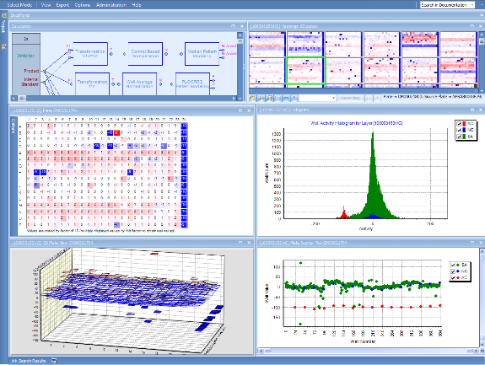
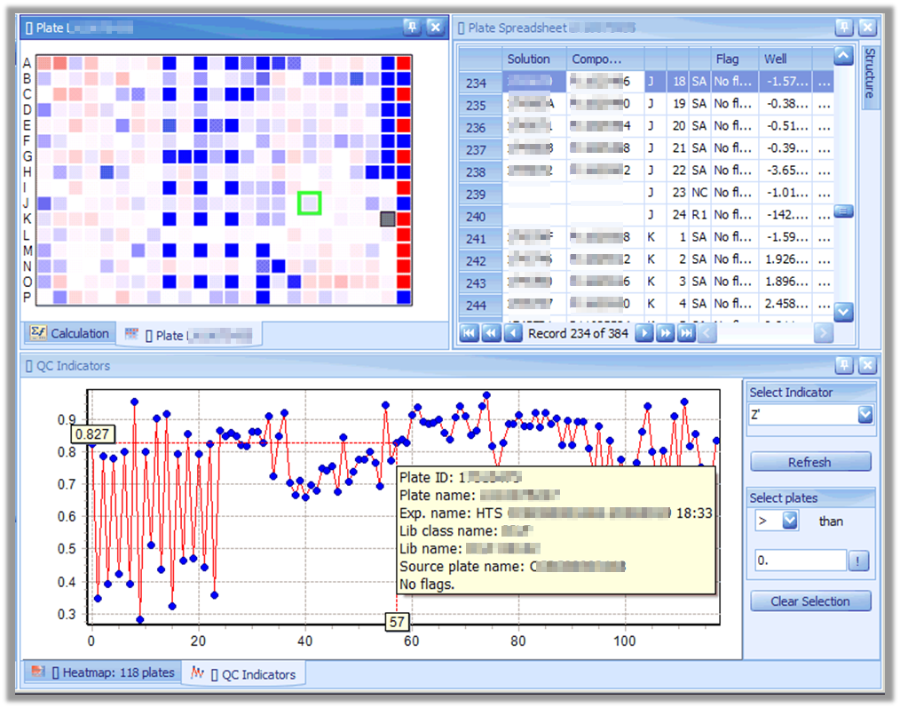
HTS DATA MANAGEMENT SYSTEM
SUMMARY
KEY HIGHLIGHTS
A system aimed at decision support on compound testing prioritization. A streamlined solution for HTS (High Throughput Screening) and Profiling data quality assurance as well as for computation and visualization tasks on large data sets
New scalable technologies assembled into a coherent system
Novel data visualization and quality assurance algorithms
Calculation methods for primary HTS data processing (data analysis and data reduction): pre-transformation, transformation, normalization, pattern modeling, correction, and quality control
Various curve-fitting methods for secondary data screening
Flags, masks, and annotations to provide “companion” information about the validity, reliability, or the degree of belief for numeric values
~40 QC indicators, 5 pre-transformation methods, ~30 pre-defined transformations, custom transformation methods
Java, Spring, Oracle RAC, C#, DevExpress, TeeChart, SOAP, Hessian
Notes:
Multi-tier application aimed to facilitate the HTS in the pharmaceutical company. Both primary and secondary screening supported: HTS data automated quality control, pattern modeling and correction, curve fitting, publishing of results, various data visualizations.
The HTS data management system was built for the client to manage their high throughput screening data, and received an internal client's award for scientific software excellence. It is a high-performance data analysis platform for experiments that produce huge quantities of data. The system outperforms commercial solutions and is a scalable and versatile enterprise application. It’s extensible and flexible architecture allows new data processing and calculations. The client’s satisfaction with the system is high: The program has been continued and expanded, with extension for new user groups: the number of users has increased from ~50 to ~200 and a second server has been set up in Cambridge, MA.
Challenge
The client requested EPAM to implement a streamlined solution for HTS and Profiling data quality assurance, as well as for computation and visualization tasks on large data sets. The client requested a solution that is flexible, can be independently extended, is open with respect to interfaces and technical standards, is modular, and exhibits adequate performance under the current and future data loads.
Solution
EPAM developed an implementation that carries over the best features of the various subsystems, introduces new scalable technologies, and assembles them into a coherent system that can fulfill the future needs of a global screening organization. The application received an internal award within the client’s organization for innovation. EPAM is continuously improving the system’s functionality in close cooperation with the client’s project team.
Usage and Loading
2 servers (1 Europe, 1 US)
Database size: more than 1 TB each.
Number of users: about 700 worldwide.
Number of geographical sites: 5 (US, Europe, Asia).
Number of concurrent users: about 50.
Technologies
Server: Java, Apache Tomcat, Spring framework.
Database: Oracle RAC.
Clients: C#, DevExpress, TeeChart.
Client-Server interaction: web service proxy with pluggable protocol, both SOAP and Hessian supported.
Features
Definition and configuration of assays, including:
Core data entry and relationship to research programs.
Defining assay structure (tests, layers, parameters).
Setting up the calculation procedure to be conducted (methods, parameters, use of data layers).
Test and layer specific variable and Quality Control settings (parameters).
Plate and readout visualization.
UI with the possibility for a user to work in different modes, which are Assay Configuration, QC Monitoring, Interactive Calculation, and Experiment Management.
Support for publishing from “operational” database to warehouse.
Support for reporting and export.
Calculation methods for primary HTS data processing (data analysis and data reduction), such as pre-transformation, transformation, normalization, pattern modeling, correction, and quality control.
Various curve-fitting methods for secondary data screening.
Supporting flags, masks, and annotations to provide “companion” information about the validity, reliability, or the degree of belief that the system or a scientist associates with a particular numerical value.
Scatterplot/trendplot display of summary statistics, QC indicators for the selected plate-/readout group.
Heatmap displays of the readout values of the plates/readouts.

Slide 27
C[C@H]([C@@H](C(=O)N[C@@H](C(C)C)C(=O)N[C@@H](CC(C)C)C(=O)N[C@@H]([C@@H](C)O)C(=O)N[C@@H](CCCCN)C(=O)N[C@@H](CCSC)C(=O)N[C@@H](CC1=CC=C(C=C1)O)C(=O)N2CCC[C@H]2C(=O)N[C@@H](CCCNC(=N)N)C(=O)NCC(=O)N[C@@H](CC(=O)N)C(=O)N[C@@H](CC3=CN=CN3)C(=O)N[C@@H](CC4=CNC5=CC=CC=C54)C(=O)N[C@@H](C)C(=O)N[C@@H](C(C)C)C(=O)NCC(=O)N[C@@H](CC6=CN=CN6)C(=O)N[C@@H](CC(C)C)C(=O)N[C@@H](CCSC)C(=O)O)NC(=O)CNC(=O)CNC(=O)CNC(=O)[C@H](C)NC(=O)[C@@H]7CCCN7C(=O)[C@H](CC(C)C)NC(=O)[C@@H]8CCCN8C(=O)[C@H](C(C)C)N)O
C1C2CC3(CC(N)C(N)=O)CC(C2)CC1C3.CC1OC(OC2C(OC3C(C)(C)C4CCC5(C)C6(C)CCC7(C(OC8OC(COC9OC(CO)C(O)C(O)C9O)C(O)C(O)C8O)=O)CCC(C)(C)CC7C6=CCC5C4(C)CC3)OCC(O)C2O)C(O)C(OC2OCC(O)C(O)C2O)C1O.C1C=C(C=O)C=C(/C=N/NC(NN2C(=O)C3=CC(S([O-])(=O)=O)=C(N)C4=C3C(=CC(S([O-])(=O)=O)=C4)C2=O)=O)C=1.C1C2C(N)=C(S([O-])(=O)=O)C=C3C(N(NC(NN)=O)C(=O)C(C=23)=CC=1S([O-])(=O)=O)=O.C[C@@H]1O[C@@H](O[C@H]2[C@H](OC3C=CC(C4OCC5C4COC5C4C=CC(O)=C(OC)C=4)=CC=3OC)O[C@H](CO)[C@@H](O)[C@@H]2O)[C@H](O)[C@H](O)[C@H]1O.C[C@@H]1O[C@@H](OC[C@H]2O[C@@H](OC3C(CC=C)=CC4OCOC=4C=3)[C@H](O)[C@@H](O)[C@@H]2O)[C@H](O)[C@H](O)[C@H]1O.CCC(C(NC=O)C(NC1C(=O)NC(CC2C=CC(OC)=CC=2)C(=O)NC(C(C)C)C(=O)N2C(CC(O)CN2)C(=O)NC(CC(C)C)C(=O)N(C)C(C(C)C)C(=O)OC1C)=O)C.C[C@@H](O)[C@H](NC(CNC(CNC(CNC([C@@H](NC([C@H]1N(C([C@@H](NC([C@H]2N(C([C@@H](N)C(C)C)=O)CCC2)=O)CC(C)C)=O)CCC1)=O)C)=O)=O)=O)=O)C(N[C@H](C(N[C@H](C(N[C@H](C(N[C@H](C(N[C@H](C(N[C@H](C(N1[C@H](C(N[C@H](C(NCC(N[C@H](C(N[C@H](C(N[C@H](C(N[C@H](C(N[C@H](C(NCC(N[C@H](C(N[C@H](C(N[C@H](C(O)=O)CCSC)=O)CC(C)C)=O)CC2NC=NC=2)=O)=O)C(C)C)=O)C)=O)CC2C3C(=CC=CC=3)NC=2)=O)CC2NC=NC=2)=O)CC(N)=O)=O)=O)CCCNC(N)=N)=O)CCC1)=O)CC1C=CC(O)=CC=1)=O)CCSC)=O)CCCCN)=O)[C@H](O)C)=O)CC(C)C)=O)C(C)C)=O.C[C@@H]1O[C@@H](O[C@@H]2[C@@H]3O[C@]3(CO)C3[C@H]2C=CO[C@H]3O[C@@H]2O[C@H](CO)[C@@H](O)[C@H](O)[C@H]2O)[C@H](OC(C)=O)[C@H](OC(C)=O)[C@H]1OC(/C=C/C1C=CC=CC=1)=O.CC(OC1C(OC(C)=O)[C@H](O[C@@H]2C(C)(C)C3[C@@]4([C@]5(C(C[C@@H]3O[C@@H]3OC(CO)[C@@H](O)C(O)C3O)[C@@]3(C)[C@@](C)(C(C6(C)O[C@H](C(O)(C)C)CC6)[C@H](O)C3)CC5)C4)CC2)OC[C@H]1O)=O.CC1OC(OCC2OC(OC3C(C)(C)C4CCC5(C)C6(C)CC(O)C7(C(OC8OC(COC9OCC(O)C(O)C9O)C(OC9OCC(O)C(OC%10OCC(O)C(O)C%10O)C9O)C(O)C8O)=O)CCC(C)(C)CC7C6=CCC5C4(C)CC3)C(O)C(O)C2O)C(OC2OCC(O)C(O)C2O)C(O)C1O.CC(O[C@@H]1[C@]23C(O)O[C@@]4(CCC5[C@@]6(C)CC[C@H](O[C@@H]7OC[C@H](O[C@@H]8O[C@H](CO)[C@@H](O)[C@H](O)[C@H]8O[C@@H]8OC[C@@H](O)[C@H](O)[C@H]8O)[C@H](O)[C@H]7O[C@@H]7O[C@H](CO)[C@@H](O)[C@H](O)[C@H]7O)C(C)(C)C6CC[C@@]5(C)[C@]4(C)C[C@H]2O)C3CC(C)(C)C1)=O.CC(N[C@H]1[C@H](O[C@@H]2C(C)(C)C3CC[C@@]4(C)[C@]5(C)CC(O)[C@@]6(C(OC7OCC(O)C(O)C7O)=O)CCC(C)(C)C[C@H]6C5=CCC4[C@@]3(C)CC2)O[C@H](COC2OCC(O[C@H]3OC[C@](O)(CO)[C@H]3O)C(OC3OCC(O)C(O)C3O)C2O)[C@@H](O)[C@@H]1O)=O.COC1C=C2C3C(C(=O)C4=C2C2=C(C5C=CC6C(C7C(C8C=6C=5C(=C(OC)C=8)C=12)=CC=CC=7)=O)C=C4)=CC=CC=3.BrBr
28
29

Slide 28
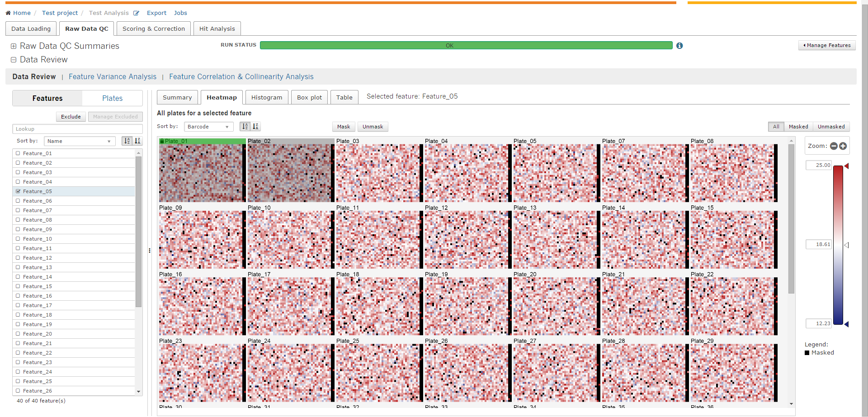
Multi-Parametric Data Analysis Application
SUMMARY
KEY HIGHLIGHTS
Platform capable of supporting multi-parametric numerical analysis services, visualizations, and metadata capabilities for high-dimensional assay technologies.
Provides a scalable and unified solution for all scientists to capture, organize, analyze, and visualize these data and share their results across teams and systems.
A tool with iterative analysis capabilities, supporting an arbitrarily large number of readout layers
Differentiated from legacy, non-scalable, incompatible or proprietary tools as they emerge under the urgent unmet needs in the scientific community
High-performant visualization solution based on WebGL, HTML, D3.js
Visualizations available:
Multiple Heatmap: changing color scale on the fly and zoom
Single Heatmap: enables reviewing heatmap in detail, set masks
Single and Multiple Histograms
Whisker plots
Correlation matrix
Dendrogram

Slide 29
C/C=C(/C(OCC1OC(OC2C(OC3OC(COC(/C(/C)=C/C)=O)C(O)C(O)C3OC3OC(COC(/C(/C)=C/C)=O)C(OC(/C(/C)=C/C)=O)C(OC(/C(/C)=C/C)=O)C3O)OC(COC(/C(/C)=C/C)=O)C(O)C2O)C(O)C(O)C1O)=O)\C.C/C=C(/C(OCC1OC(OC2OC(COC(/C(/C)=C/C)=O)C(OC3OC(CO)C(OC(/C(/C)=C/C)=O)C(OC(/C(/C)=C/C)=O)C3O)C(O)C2O)C(O)C(O)C1OC1OC(CO)C(OC(/C(/C)=C/C)=O)C(O)C1O)=O)\C.C/C=C(\C)/C(OC[C@@H]1[C@@H](O)[C@H](O)[C@@H](O)[C@H](O[C@@H]2[C@@H](O)[C@H](O)[C@@H](COC(/C(/C)=C/C)=O)O[C@@H]2O[C@@H]2[C@H](O[C@H]3[C@H](O)[C@@H](O)[C@H](O)[C@@H](COC(/C(/C)=C/C)=O)O3)[C@@H](O)[C@H](O)[C@@H](COC(/C(/C)=C/C)=O)O2)O1)=O.C/C=C(\C)/C(OC[C@@H]1[C@@H](O)[C@H](O)[C@@H](O)[C@@H](O[C@@H]2[C@H](O)[C@@H](O)[C@H](O)[C@@H](COC(/C(/C)=C/C)=O)O2)O1)=O.CC1OC(OC2C(O)C(OC3C(O)C(OC4C(O)C(OC[C@H]5O[C@@H](O[C@@H]6C(C)(C)C7CC[C@@]8(C)[C@]9(C)CC(O)[C@@]%10(C(OC%11OCC(O)C(O)C%11O)=O)CCC(C)(C)C[C@H]%10C9=CCC8[C@@]7(C)CC6)[C@H](NC(C)=O)[C@@H](O)[C@@H]5O)OC(C)C4O)OCC3O)OC(C)C2O)C(O)C(O)C1O.C[C@@]12C3CC=C4[C@@H]5CC(C)(C)CC[C@]5(C(O)=O)[C@H](O)C[C@@]4(C)[C@]3(C)CCC1[C@@](C=O)(C)[C@@H](O[C@@H]1O[C@H](C(O)=O)[C@@H](O)[C@H](O[C@@H]3OC[C@@H](O)[C@H](O)[C@H]3O)[C@H]1O[C@@H]1O[C@H](CO)[C@H](O)[C@H](O)[C@H]1O)CC2
31
C1CC1N=C(N)N.C1CC1N=C(N)N.OS(=O)(=O)O
CC1C(C(C(C(O1)OC2CCC3([C@H]4CCC5(C(CCC5([C@@H]4CCC3(C2)O)O)C6=COC(=O)C=C6)C)C=O)O)O)OC7C(C(C(C(O7)CO)O)O)O
32
30

Slide 30

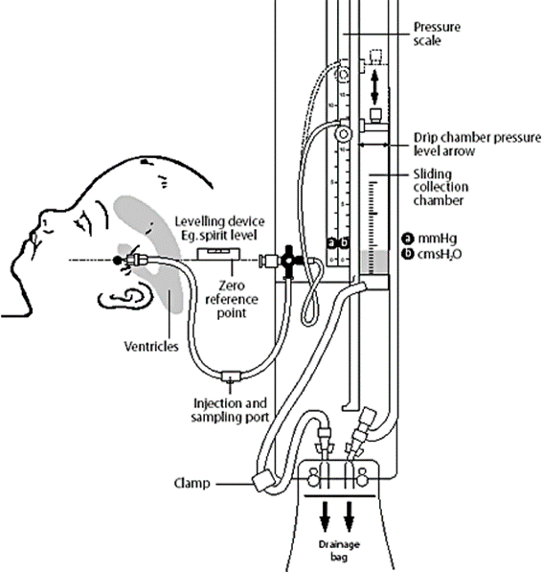
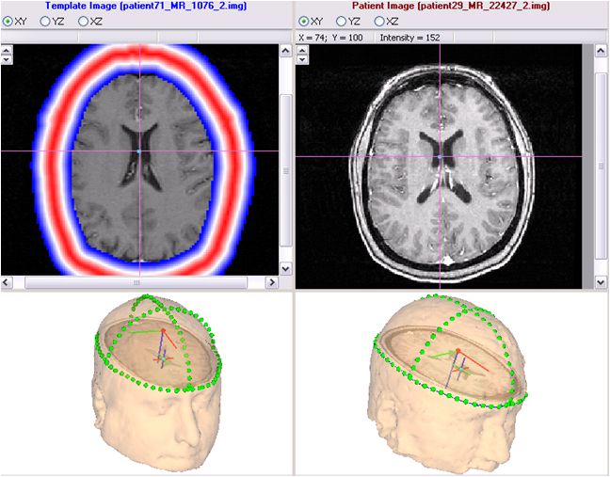
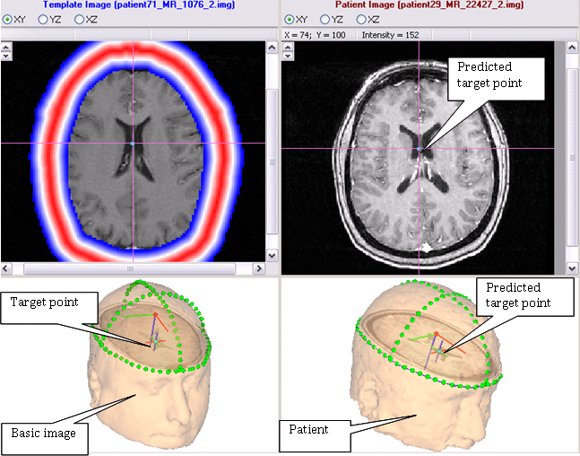
Reducing Guesswork in Neurosurgery
Project Details
Image-guided targeting of External Ventricular Drain (EVD) used in neurosurgery to monitor and relieve raised intracranial pressure (ICP) & hydrocephalus when normal flow of cerebrospinal fluid (CSF) around the brain is obstructed
Innovative algorithm based on hypothesis that ventricle position is determined by head shape
Unique target point prediction based on optimal affine transformation that maps registered landmarks on patient’s head onto segmented template MR images with manually labeled target points
Critical for emergency medicine and ICU/CCU environments
Highlights
Reduced unpredictability and guesswork
Number of attempts reduced to 1 lowering risk of after-effects and increasing patient's safety
98% accuracy of prediction
Landmark location schemes avoiding occipital lobe of head - important advantage for surgeons
Saved lives due to fast and accurate ICP relief
Notes:
An external ventricular drain (EVD), also known as a ventriculostomy or an intra-ventricular catheter (IVC), is a device used in neurosurgery that monitors and/or relieves raised intracranial pressure (ICP) and hydrocephalus when the normal flow of cerebrospinal fluid (CSF) around the brain is obstructed.
Some of the main reasons for EVD placement include head trauma, subarachnoid or intra-ventricular hemorrhage, or obstructive hydrocephalus.
Doctors typically have to perform EVD placement purely based on personal experience, hand skills, and guesses, hoping to hit the right target. Hence, the result is somewhat unpredictable and it might take multiple attempts before succeeding.
Every attempt increases the chance of intracranial hemorrhage as well as infection in the patient, plus it adds to the time and cost of care.
In emergency cases, when intracranial pressure raises dramatically, for example as injury result, it is impossible to perform head tomogram immediately. This means that a surgeon while performing EVD placement does not know where is so called 4-th ventricle and he needs to operate on base of personal experience, hand skills, and guesses. The instrument placement point is determined anatomically, but the direction has to be guessed.
EPAM has conducted a significant research and came up with an innovative algorithm based on the hypothesis elaborated during research that patients with similar shape of the head have similar locations of ventricles.
EPAM developed an innovative approach and, basing on the preliminary MRIs database labelling, verified this hypothesis:
Construct a database of template images with manually labeled target points. Our database contains about a hundred of labelled images
Using a portable electromagnetic navigation system, mark the set of landmarks on the patient’s head (points cloud).
Find the optimal affine transformation, which maps the points cloud to the template surface.
The predicted coordinates of the patient’s target point are the coordinates of the template target point transformed with the inverse transformation.
Cross validation showed 100% hits.
EPAM has conducted additional research and has developed user interface for optimal selection of landmarks on the patient’s head. As the result, EPAM has suggested landmark location schemes that do not involve the occipital lobe of the head, which is an important advantage for surgeons.
The algorithm was implemented as a Windows application with the visualization of all manipulations together with some verification capabilities.

Slide 31
C[C@@H]1[C@H]([C@@H]([C@@H]([C@H](O1)O[C@H]2[C@@H](CO[C@H]([C@@H]2O)O[C@H]3[C@@H](O[C@H]([C@@H]([C@@H]3O)O)O[C@@H]4[C@H]([C@H](CO[C@H]4OC(=O)[C@@]56CC[C@@]7(C(=CCC8[C@]7(C[C@H](C9[C@@]8(C[C@H]([C@H]([C@@]9(C)CO)O[C@H]1[C@@H]([C@H]([C@@H]([C@H](O1)CO)O)O)O)O)C)O)C)[C@@H]5CC(CC6)(C)C)C)O)O)C)O[C@H]1[C@@H]([C@H]([C@@H](CO1)O)O)O)O)O)O
CC1CCC2(CCC3(C(=CCC4C3(CCC5C4(CCC(C5(C)C)OC6C(C(C(CO6)O)O)OC7C(C(C(C(O7)CO)O)O)O)C)C)C2C1(C)O)C)C(=O)OC8C(C(C(C(O8)CO)O)O)O
33
37
C1CCN2C[C@@]3(C[C@@H]([C@@H]2C1)C[C@@H]4[C@H]3NCCC4)C5CCCCN5
CC(C)C[C@@H](C(=O)O)N.C1=CC=C(C=C1)C[C@@H](C(=O)O)NC(=O)OCC2C3=CC=CC=C3C4=CC=CC=C24
34
38
CC[C@H](C)[C@@H](C(=O)NCC(=O)N[C@@H]([C@@H](C)CC)C(=O)N[C@@H](CC(C)C)C(=O)N[C@@H]([C@@H](C)O)C(=O)N[C@@H](C(C)C)C(=O)O)NC(=O)CNC(=O)[C@H](C)NC(=O)[C@H](C)N.CC(=O)O
35
CC[C@@]1(CC2C[C@@](C3=C(CCN(C2)C1)C4=CC=CC=C4N3)(C5=C(C=C6C(=C5)[C@]78CCN9C7[C@@](C=CC9)(C([C@@](C8N6C)(C(=O)N)O)O)CC)OC)C(=O)OC)O
CN1CCCC1C2CCC[N-]C2.CN1CCCC1C2CCC[N-]C2.CN1CCCC1C2CCC[N-]C2.C(#N)S.[Ni+2]
36
39

Slide 32


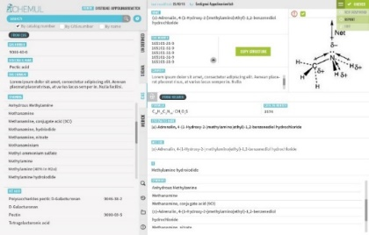

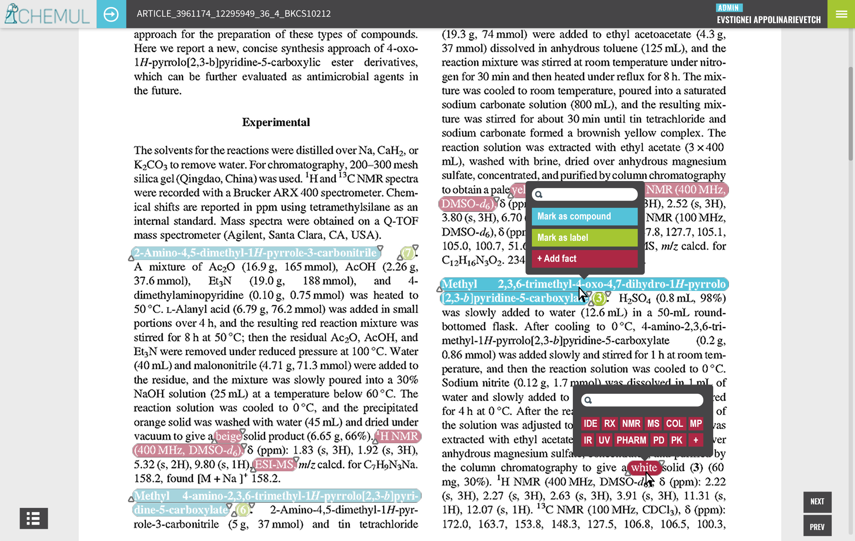
CHEMUL - Automated Chemical Data Excerption Tool
SUMMARY
KEY HIGHLIGHTS
EPAM created an Automated Chemical Data Excerption Tool comprising a combined professional knowledge base for quick retrieval of reference chemical information and Document Processing Workflow enabling automated pre-excerption of chemical data.
Combined professional Chemical Knowledge Base
Automatic Chemical Entities Retrieval Engine
Content curation: OCR PDF articles and normalization of extracted texts
Machine Learning: extract relevant sentences containing valuable information
Natural Language Processing: context-based detection of chemical named entities
Semi-automated excerption with 75.5% accuracy
Chemical structure image recognition, 95-99% accuracy
Manual relevancy check effort reduced more than twice
Increased speed & cost effectiveness of excerption: 7.7% increase of completed tasks number per week
HTML5 , JS, CSS 3, Bower, Sass, Compass, Bootstrap, AngularJS, JSHint, Java, Spring MVC, Spring ORM, Solr, MongoDB, Spring Security, JUnit
Notes:
Challenge
The client, a publishing services provider, runs a number of data excerption projects. The client desires to optimize the process of excerpting chemical data by automating as many of the excerption steps as possible and achieving results of required quality within a minimum time. Currently, the curation process has the following specifics:
Chemical content curation teams use several recognized chemical reference books in PDF format to excerpt chemical compounds and their properties from scientific papers and patents
Information search is mostly performed across multiple PDF and Excel files
Content curation teams have to re-draw chemical structures of common compounds over and over again
A smart mechanism is required to:
Automate as many curation steps as possible
Improve manual curation by providing comprehensive hints for excerptors
Solution
To support the client's program of optimizing the process of chemical data excerption, EPAM came up with the initiative to implement an Automated Chemical Data Excerption Tool comprising of:
A combined professional Chemical Knowledge Base available to operators that accumulates all the necessary knowledge in one place and eliminates the necessity for curators to browse through several reference books and repeatedly fill in compound cards and redraw structures that they have already come across before.
Document Processing Workflow that enables automatic pre-processing of documents, eventually boiling down the curators' role to only the quality control of the automatically processed results.
The Chemical Knowledge Base is a web application that serves as a reference guide. Using recognized chemical reference books and chemical structure editors, the application builds up its own combined professional knowledge base and makes it available to operators. The tool is empowered with a smart data mining mechanism that is able to detect most relevant places in the documents where the required information is most likely to occur.
In the Chemical Knowledge Base, each dictionary item contains the following compound-related attributes:
Compound’s main name (trivial name, if any);
Molecular formula
List of all its synonyms
Compound’s molecular structure as a .mol file
Document Processing Workflow performs simple automatic pre-excerption based on the previously constructed dictionary:
Find all compounds present in the loaded document, highlight them, and mark the document as irrelevant if there are no compounds from the dictionary
Find chemical reactions between the extracted compounds present in the document and highlight them accordingly linking to their components
Find compound properties, referred to as facts, using the regular expressions approach and layout parsing and link them to the corresponding compounds
Compose all the information together to comprise a pre-filled form for excerptors’ reporting application
The high-level concept of the solutions includes:
Compound profiles with MOL files
Search Engine with autosuggest
Data mining hinting engine
User-friendly interface
EPAM is planning to maximize the level of automatic pre-excerption and provide a convenient and interactive interface for data excerptors. Most of their work would ideally be limited to accepting or rejecting automatically extracted items, which should further improve the system by adjusting its learning mechanisms. Within the scope of these activities, EPAM is currently working on:
Improving pre-excerption of compound properties (facts) using Natural Language Processing techniques, such as dependencies parsing. This would allow extracting facts from natural sentences, and not only from strictly defined layouts.
Making the documents interactive (actions with a highlighted compound: show links to other places in the document where this compound is mentioned, show its molecule structure; document cross-reference; generating an index of all extracted objects; etc.). This section intends that the team will work closely with the end users in order to understand which interaction will be helpful.
Implementing workflow control module (tasks assignment, progress tracking, analytics, dashboard, etc.).
Implementing collaboration module (comments in documents, chat, etc.). All social features will be coordinated with the content team needs.
Technologies:
Front end: HTML5 , JS, CSS 3, Bower, Sass, Compass, Bootstrap, AngularJS, JSHint
Back end: Java, Spring MVC, Spring ORM, Solr, MongoDB, Spring Security, JUnit
Features:
Single Sign On Authentication
Verified data from official relevant sources
Flexible search providing most relevant results
Processes structured and unstructured data
Rule-based and statistical NLP approaches
Benefits:
Increasing the accuracy and speed of content excerption.
Increasing the speed of content curation teams making them more competitive on the market of content excerption.
Being an innovative technology, this application will be helpful in promoting excerption services.
Increasing cost effectiveness of data curation projects

Slide 33
CC(C)C[C@@H](C(=O)O)N.C1=CC=C(C=C1)C[C@@H](C(=O)O)NC(=O)OCC2C3=CC=CC=C3C4=CC=CC=C24
CC[C@@]1(CC2C[C@@](C3=C(CCN(C2)C1)C4=CC=CC=C4N3)(C5=C(C=C6C(=C5)[C@]78CCN9C7[C@@](C=CC9)(C([C@@](C8N6C)(C(=O)N)O)O)CC)OC)C(=O)OC)O
C1CC1C2=C(C=C(C=C2)C(F)(F)F)C3=NC=C4C(=N3)N(C(=O)N4)CC5=CC=C(C=C5)N6C=CC=N6
COC1=CC(=CC(=C1)C2=C(C=CC(=C2)C3=NN(C(=C3CC4=CC(=C(C=C4)[SH+](=O)N)F)CC5CC5)C6=NC(=CS6)C(=O)O)F)OC
C1C2CC3(CC1CC(C2)(C3)O)C(C[C@@H]4C5=C(C=CC=C5F)C6=CN=CN46)O
CC1=CC(=CC(=C1)F)C2=CN=C3C=CC(=CC3=C2N4CC[C@@H]5[C@@H](C4)NCCO5)C6=NC=CC(=C6N)/C=N\OC
CN(C)S(=O)(=O)NC(=O)[C@H]1C[C@H](CN1C(=O)C(C2=CC=CC=C2)C3=CC=CC=C3)N(C)CCCC4=CC=C(C=C4)F
C1CN(CCC1C(=O)N2CC(C2)(F)F)C3=C(C=NC=C3)NC(=O)C4=C5N=CC(=CN5N=C4N)F
CC[C@@]1(CC2C[C@@](C3=C(CCN(C2)C1)C4=CC=CC=C4N3)(C5=C(C=C6C(=C5)[C@]78CCN9C7[C@@](C=CC9)(C([C@@](C8N6C)(C(=O)N)O)O)CC)OC)C(=O)OC)O
C[C@@]1(CCC1NC(=O)C2=C3N=C(C=C(N3N=C2)NC)NC4=CC=CN(C4=O)C5CC(C5)(F)F)OC
C1[C@]2([C@@H]([C@@H]([C@H]([C@H](O1)O2)NC(=O)C(F)(F)F)O)O)CO
CC1=CC(=CC(=C1)F)C2=C(C3=CC(=C(C=C3N=N2)Cl)C4CCCC5C4NC(=O)N5)N6CCC(CC6)N
CCC(=O)CN1C(=O)C2C(N=CN2CC(=O)NC3=CC=CC(=N3)C4=CC(=C(N=C4)C)C(F)(F)F)N(C1=O)C
CC#CC1=CN=CC(=C1N)C2=CC3=C(C(=CN=C3C=C2)C4=CC(=CC(=C4)F)F)N5CC[C@@H]6[C@@H](C5)NCCO6
CN1CC2(CCN(CC2)C3=C(C=NC=C3)NC(=O)C4=C5N=CC(=CN5N=C4N)F)CC1=O
CS(=O)(=O)C1=CC2=C(C(=C1)F)C(=NO2)N[C@@H]3CN4CCC3CC4
CC(C)(C)C1=CC=C(S1)C#CC2=C(C=CC(=C2)C3=NN(C(=C3CC4=CC(=C(C=C4)[SH+](=O)N)F)CC5CC5)C6=NC(=CS6)C(=O)O)F
C[NH+]1CCN(CC1)C(=O)C2CCN(CC2)C3=C(C=NC=C3NC(=O)C4=C5N=CC(=CN5N=C4N)F)F
C[C@H]([C@@H](C(=O)N[C@@H](CCCN=C(N)N)C(=O)O)N)O.C[C@H]([C@@H](C(=O)N[C@@H](CCCN=C(N)N)C(=O)O)N)O.OS(=O)(=O)O
CN1CCN(CC1)C2=C(C=CC=N2)C3=NC=C4C(=N3)N(C(=O)N4)CC5=CC=C(C=C5)C6=NC(=CN6C)C(F)(F)F
CONC(=O)NC1=C(C=CC=N1)C2=CC3=C(C(=CN=C3C=C2)C4=CC(=CC(=C4)F)F)N5CC[C@@H]6[C@@H](C5)NCCO6
CC1=CC=CN(C1=O)CC2(C(=O)NC(=O)N2)C3=CC=CC=C3OC(F)(F)F
C[C@H]1CC1(C2=CN(N=C2)C)NC(=O)C3=CC4=C(N3)C=CC(=C4F)Cl
CN1C2CCC1CN(C2)C(=O)C3CCN(CC3)C4=C(C=NC=C4NC(=O)C5=C6N=CC(=CN6N=C5N)F)F
40
63

Slide 34
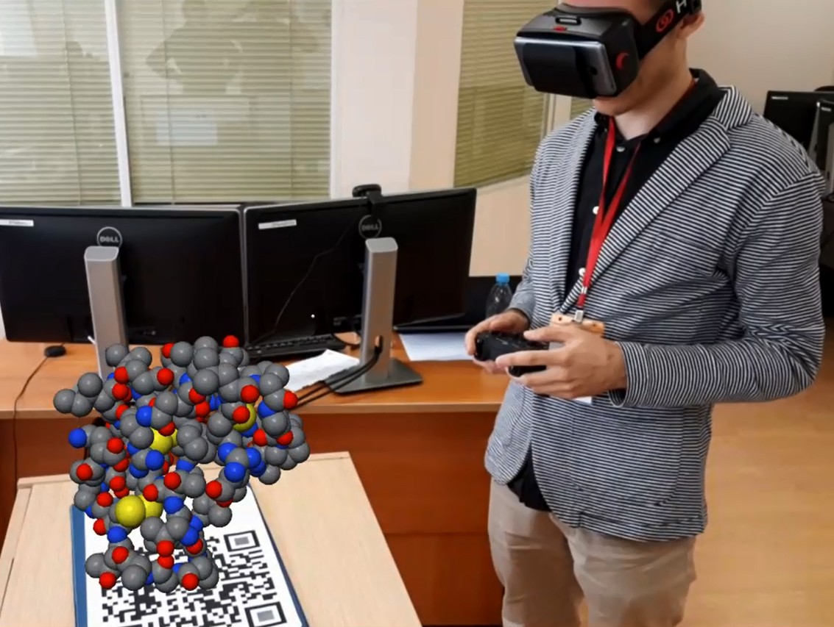

AUGMENTED REALITY IN MOLECULAR MODELING
MOBILE 3D MOLECULE VIEWER
Proof of concept for use of Virtual / Augmented Reality (VR/AR) technology in structural biology and molecular modeling workflows
VR representation of molecules (proteins and ligands) using HTC Vive VR device
Data coming from Protein Data Bank file via several processing steps
Based on Unity3D engine
Augmented reality functionality powered by Vuforia library with QR-code used as an anchor to real world
Molecules representation controlled using a wireless gamepad connected to a smartphone: Scaling, Rotation, Movement
Three molecular drawing methods, various color modes
Multi-user mode

Slide 35
CC1=C(N2[C@@H]3C[C@@H]3CC2=C1C(=O)C(=O)NC4(CC(C4)(F)F)C5CNNN5)C(=O)NC6=CC(=C(C=C6)F)C#N
CN1C(=O)C2C(CC(NC2N1)NC(=O)[C@@H]3C[C@@H]3F)NC4=C(C=C(C=C4)C5CC5)S(=O)(=O)C
C1CCN(CC1)C2=C3C(=NC=C2)N=C(N3)C4C5CC(CCC5NN4)C6=CN=CC(=C6)CN7CCC(C7)(F)F
CCCCCNC1C2OC3C(N4C=C(C(O)=O)C(=O)C(C24)CC1F)CCC(N)C3.CC(NC1CC2OC3C(F)C(F)CC4C3N(C=C(C(O)=O)C4=O)C2CC1)=O.CC(OC(NC1CN(C2C3OC4C(N5C=C(C(O)=O)C(=O)C(C35)CC2F)CCC(N)C4)CC1)=O)(C)C.CNC(NC1C=C(OC2C=CC3OC4C(C5NC6C=C(C(F)(F)F)C=CC=6N=5)C4C=3C=2)фC=CN=1)=O.C[C@H](NC1C(F)=C(N2C(=O)OCC2)C=CN=1)C1C(=O)NC2C(CC(Cl)CC2)C1.C[C@H](NC1C=C(F)C=C(N2C(=O)OCC2)N=1)C1C(=O)NC2C(CC(Cl)CC2)C1.C[C@H](NC1C=C(N2C(=O)COC2)C=C(F)N=1)C1C(=O)NC2C(CC(Cl)CC2)C1.CC1N=C(NC(C2C(=O)NC3C(CC(Cl)C(F)C3)C2)C)C=CC=1C#N
64
CCN(C[C@]12CC[C@H](C1(C)C)C3=CC(=NN=C23)C4=C(C=CC=C4F)F)C(=O)CN5CCC(=O)NC5=O
CC1C(C(NN1)NC(=O)[C@@H]2C[C@H](CN2C(=O)CN3C=C(C4=C3C=CC(=C4)C5=CN=NC=C5)C(=O)C)F)C6=CC=CC=C6
CN1C(=O)C2C(CC(NC2N1)NC3=CC=CC(=N3)C(F)(F)F)NC4=C(C=C(C=C4)C5CC5)S(=O)(=O)C
CCCCCNC1C2OC3C(N4C=C(C(O)=O)C(=O)C(C24)CC1F)CCC(N)C3.CC(NC1CC2OC3C(F)C(F)CC4C3N(C=C(C(O)=O)C4=O)C2CC1)=O.CC(OC(NC1CN(C2C3OC4C(N5C=C(C(O)=O)C(=O)C(C35)CC2F)CCC(N)C4)CC1)=O)(C)C.CNC(NC1C=C(OC2C=CC3OC4C(C5NC6C=C(C(F)(F)F)C=CC=6N=5)C4C=3C=2)C=CN=1)=O.C[C@H](NC1C(F)=C(N2C(=O)OCC2)C=CN=1)C1C(=O)NC2C(CC(Cl)CC2)C1.C[C@H](NC1C=C(F)C=C(N2C(=O)OCC2)N=1)C1C(=O)NC2C(CC(Cl)CC2)C1.C[C@H](NC1C=C(N2C(=O)COC2)C=C(F)N=1)C1C(=O)NC2C(CC(Cl)CC2)C1.CC1N=C(NC(C2C(=O)NC3C(CC(Cl)C(F)C3)C2)C)C=CC=1C#N.CC(C1ON=C(C(NCC2C=CC(C3C4NC(NC4NCC3)=O)=CC=2C(F)(F)F)=O)N=1)(C)C.CC1C(CNC(C2ON=C(C(C)(C)C)N=2)=O)=CC(F)=C(C2C3NC(NC3NCC2)=O)C=1.CC1(C2N=C(C(NCC3C=CC(C4C5NC(NC5NCC4)=O)=CC=3C(F)(F)F)=O)ON=2)CC1.CC1(C)CC2N3C(=CC=2C1)C(=O)N(C1C=C(C2C4NC(NC4NCC2)=O)C=C(F)C=1)CC3.CC(OC1CN(C(NCC2C=CC(C3C4NC(NC4NCC3)=O)=CC=2C(F)(F)F)=O)C1)(C)C.C1C([N+]([O-])=O)CC2OC3C(N4CCNCC4)C(F)CC4C3N(C=C(C(O)=O)C4=O)C2C1.CC1NNC(NC2C=C(C)N=C(N3CCC(OC)(C(N[C@H](C4N=CC(N5N=CC(F)=C5)=NC=4)C)=O)CC3)N=2)C1
CC1=C(N2[C@@H]3C[C@@H]3CC2=C1C(=O)C(=O)NC4(CC(C4)(F)F)C5CNNN5)C(=O)NC6=CC(=C(C(=C6)F)F)F
CN1C=CC(=N1)C2=CC(=C(C=C2C(F)(F)F)F)C(=O)NC3=CC(=NN3C4=CC=C(C=C4)F)CC5C=CC(=O)N=N5
C1C2C(CNC1C3=CC(=CN=C3)O)NNC2C4=CC5=C(C=CN=C5N4)C6=CC=C(C=C6)F
CN1C(=O)C2C(CC(NC2N1)NC3=CC=CC(=N3)C(F)(F)F)NC4=C(C=C(C=C4)Cl)S(=O)(=O)C
C1=CC=C(C=C1)C(=O)NC2=CN=CC(=C2)C3=CNC4=NN=C(C4=C3)C5=CC6=C(C=CN=C6N5)C7=CC(=CC=C7)F
C1CCC(C1)NC2C(CC3C4C2OC5CC(CCC5N4C=C(C3=O)C(=O)O)N)F
77

Slide 36
78

Slide 37
C1=CC=CC=C1.C2C=CC=C2.C3CCCCC3.C4CCCC4.C5CC5.C6CCC6.C7CCCCCC7.C8CCCCCCC8.I>>O[C@@H]9[C@@H]([C@@H]([C@@H]([C@H](O9)CO)O)O)O
79

